Slide 1
Disney + HotStar Data Analysis
Yashwanthini Aishwariya B

Slide 2
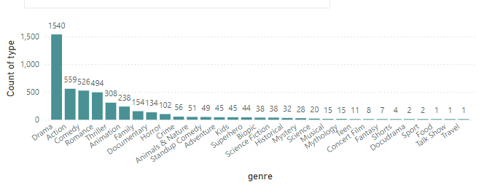
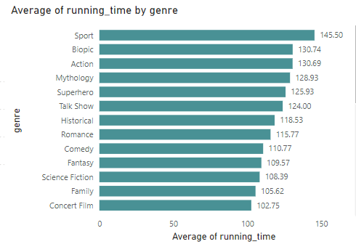
Task 1
No of. Movies = 4568
Highest no movie as per genre : Drama
Task 2
The genre sport has the highest average running time

Slide 3
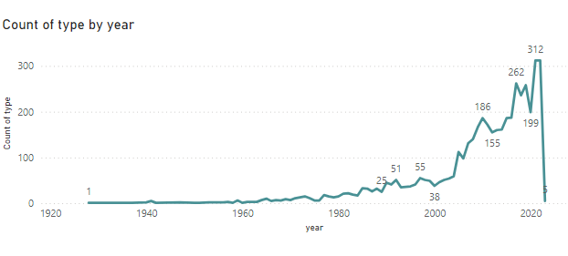
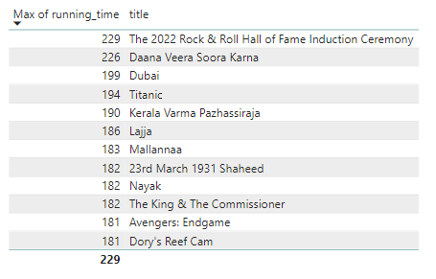
Task 3
Year 2022 and 2017 leads high in released period with the count 312 and 262
Task 4
The longest running time is 229 for movie ‘the 2022 rock & roll of fame induction ceremony’

Slide 4
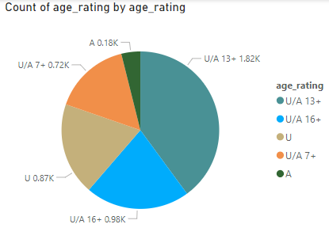
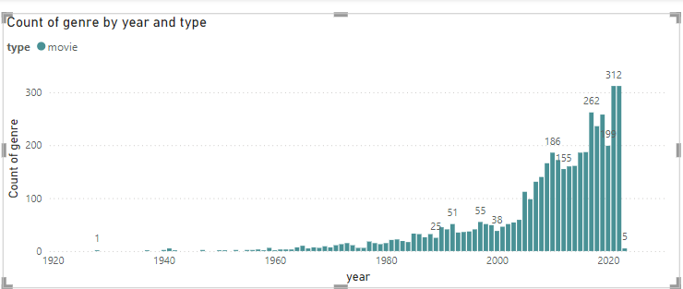
Task 5
U/A has the maximum count - 1824
Task 6
312 is the highest genre count for the period 2022

Slide 5
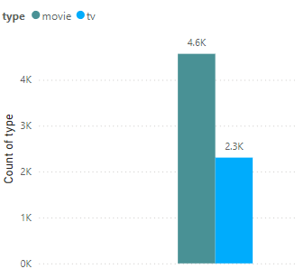
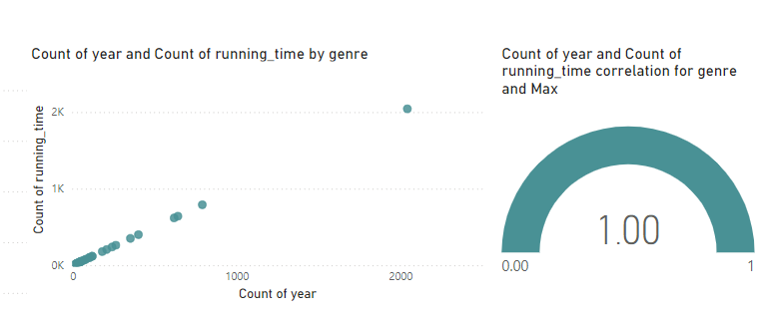
Task 7
Movie = 4568
Tv = 2306
Task 8
The correlation between year vs running time has positive correlation

Slide 6
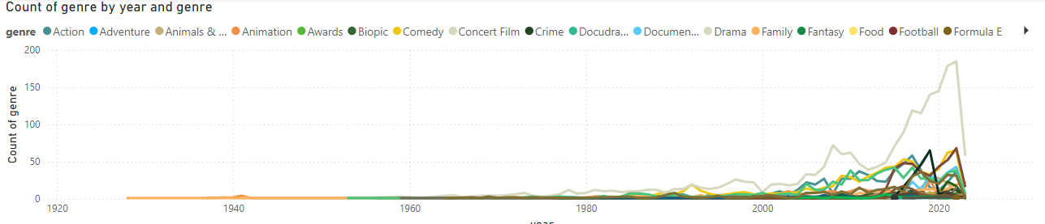
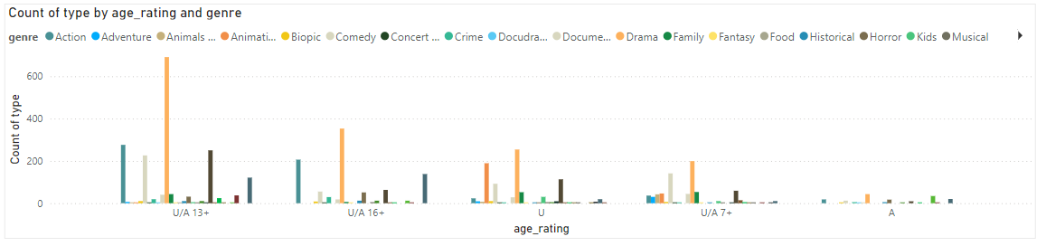
Task 9
The genre “family” is the only genre which has popularity in late 1950s and drama has the highest popularity among others
Task 10
Drama is the only genre which is liked by all aged groups

Slide 7
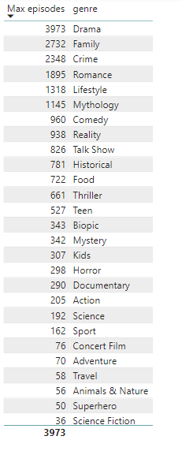
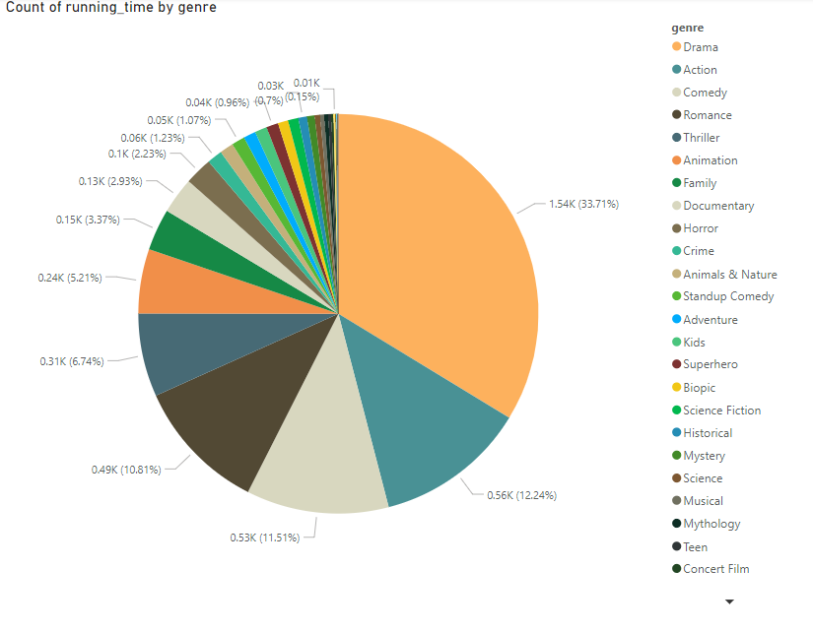
Task 11
Task 12
Drama has the highest running time above all the other genre
The movies specified for drama, family and crime has the highest top 3 ranks for maximum episode

Slide 8
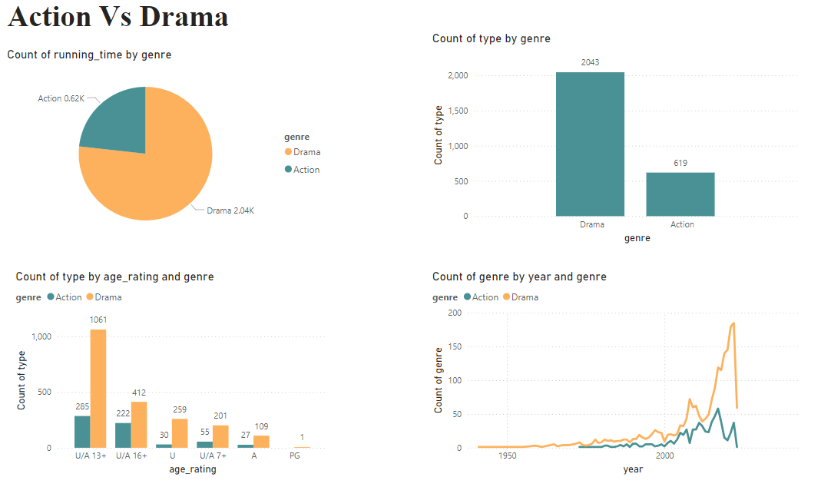
Task 12
In all the attributes drama leads over action

Slide 9
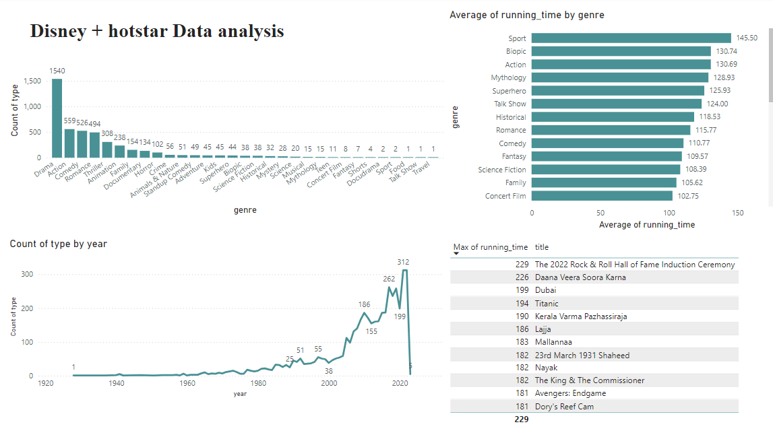
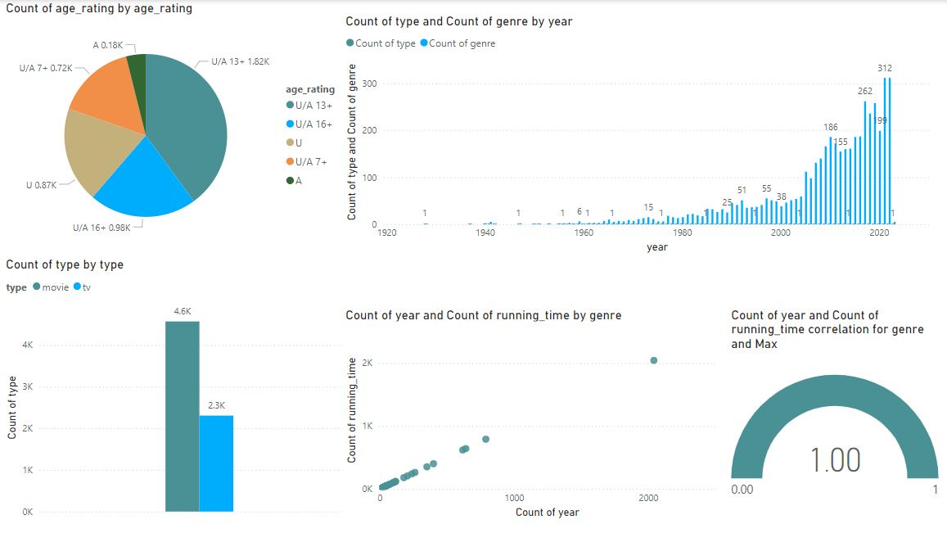
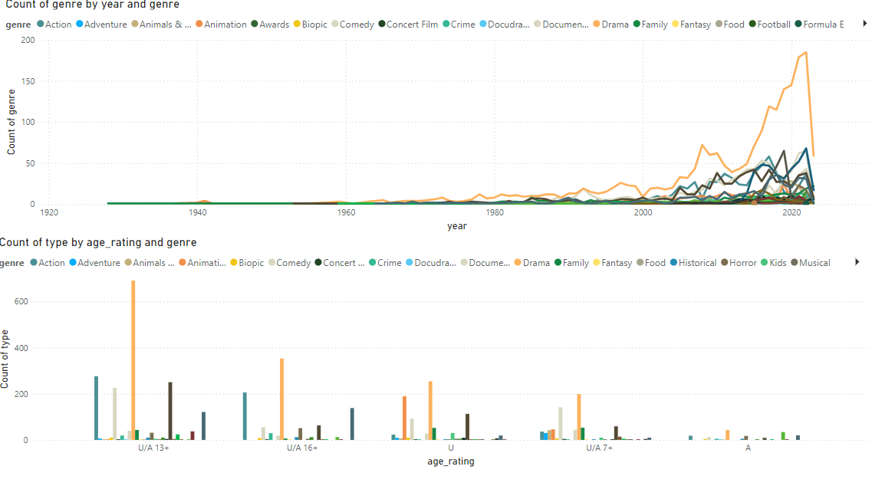
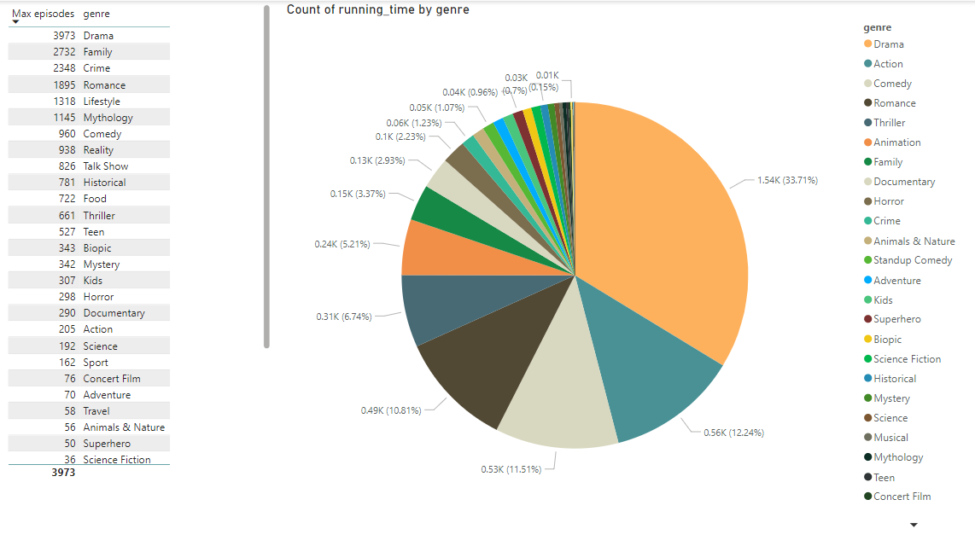
Dashboard

Slide 11
Understandings
It is clear that the genre “Drama” has the highest count
It is liked by all aged groups
Dedicated sections can be allocated for drama
In order to boost the action genre, High rated views of specific scene can be telecasted on social media for specific duration
The same can be followed for the other genre
Certain pass or membership can be implemented with top rated drama and action along with tv shows, which will improve the views of tv shows

